Slide 1

Real Time Facial Emotion Recognition Using Deep Learning
January 17th, 2025

Slide 2
CONTENTS:-
INTRODUCTION
LITERATURE REVIEW
RESEARCH METHODOLOGY
FRAMEWORKS AND LIBRARIES IN USE
CNN MODEL ARCHITECTURE
SYSTEM DIAGRAM
SYSTEM FLOWCHART
DATASETS USED
MODEL DEPLOYMENT
FUTURE SCOPE
CONCLUSION

Slide 3
INTRODUCTION:-
Facial Emotion Recognition is the process of identifying and analyzing human emotions based on facial expressions.
It has wide applications in healthcare, education, human-computer interaction, and customer service.
Recognizing emotions in real-time is challenging due to variations in facial expressions, lighting conditions, and individual differences.
Deep Learning techniques, especially Convolutional Neural Networks (CNNs), have revolutionized emotion recognition by automating feature extraction and improving accuracy.
This project focuses on building a real-time system that detects and classifies emotions effectively using CNN.

Slide 4
LITERATURE REVIEW:-
Author(s) & Year | Title / Study Focus | Methodology | Key Findings | Limitations
Viola & Jones (2001) | Rapid object detection using a boosted cascade of simple features | Used Haar cascades for facial detection | Efficient face detection algorithm; fast computation | Not robust under varying lighting and poses
Goodfellow et al. (2014) | Deep learning applications in image recognition | Introduced CNNs for object detection | CNNs achieved state-of-the-art accuracy in image tasks | Requires large datasets and high computational power
Mollahosseini et al. (2016) | Facial Expression Recognition in Real-Time Using CNN | Used CNNs with the FER2013 dataset for emotion detection | Achieved accuracy of ~66% on FER2013 dataset | Struggled with rare or subtle emotions
Zhang et al. (2019) | Real-time Emotion Detection via Deep Learning | Combined CNN with OpenCV for real-time emotion detection | Successfully implemented real-time emotion recognition | Accuracy reduced with low-resolution input
Yang et al. (2021) | Multi-modal Emotion Recognition | Used hybrid models (facial + voice data) | Improved emotion recognition through multi-modal input | Limited to datasets that contain both modalities

Slide 5
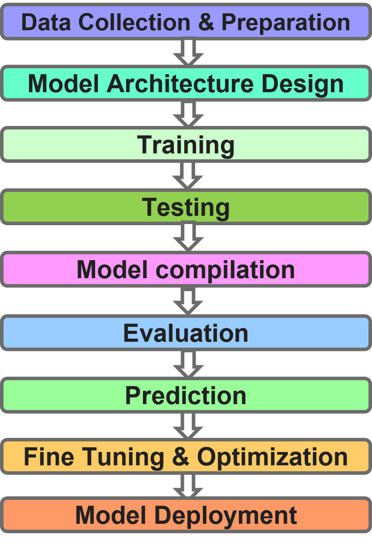
RESEARCH METHODOLOGY:-
Data Collection & Preparation
Model Architecture Design
Training
Testing
Model Compilation
Evaluation
Prediction
Fine Tuning & Optimization
Model Deployment

Slide 6
FRAMEWORKS, LIBRARIES AND TOOLS IN USE:-
TensorFlow: Provides a robust framework for building and training deep learning models.
Keras: High-level API for TensorFlow, used to simplify the implementation of neural networks.
Pandas: Used for data manipulation and analysis, ensuring efficient handling of datasets.
NumPy: Provides support for numerical computations and handling multidimensional arrays.
tqdm: Adds progress bars to loops, making training and processing tasks more trackable.
OpenCV (opencv-contrib-python): Enables face detection and image preprocessing for input data.
scikit-learn: Used for data preprocessing, splitting datasets, and evaluating the model's performance.
Jupyter Notebook: An interactive environment for developing and visualizing the model step by step.

Slide 7
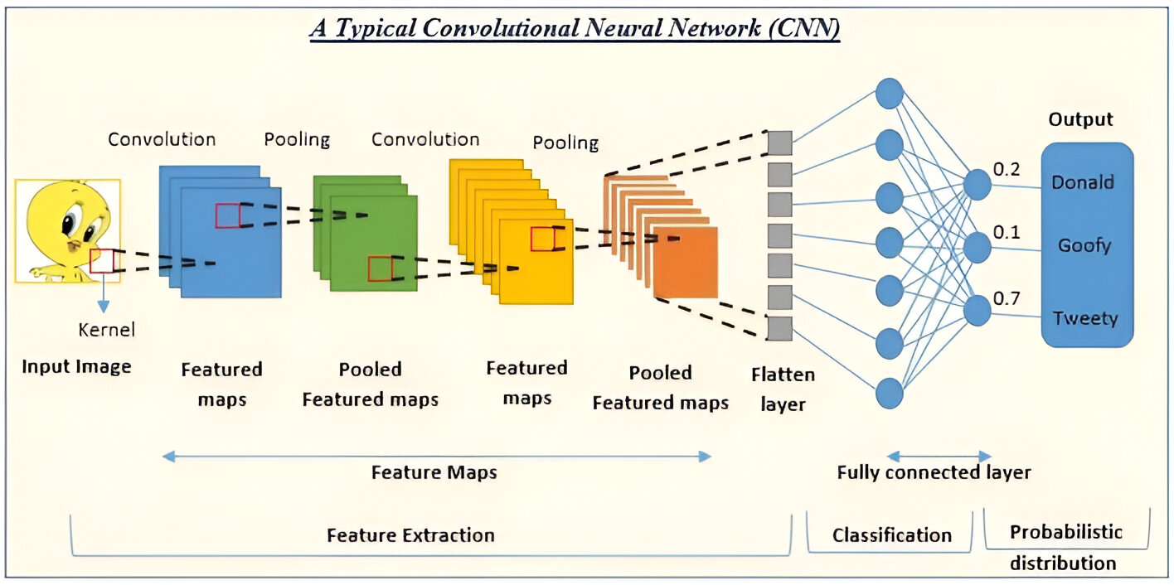

CNN MODEL ARCHITECTURE:-
Angry
Fear
Disgust Happy Sad Neutral Surprise

Slide 8
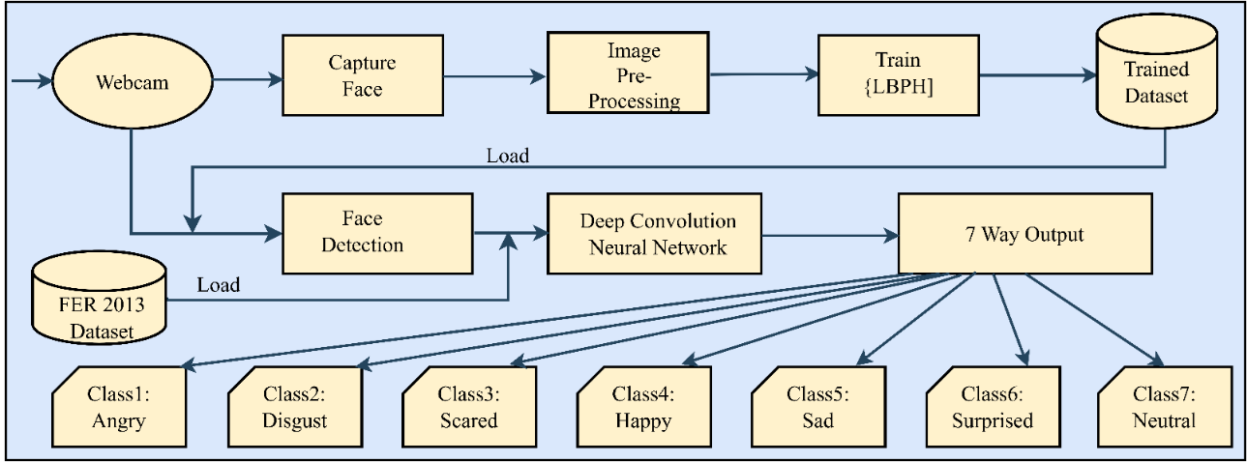
SYSTEM DIAGRAM:-

Slide 9
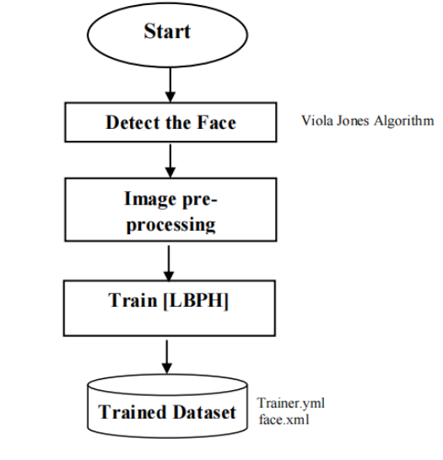
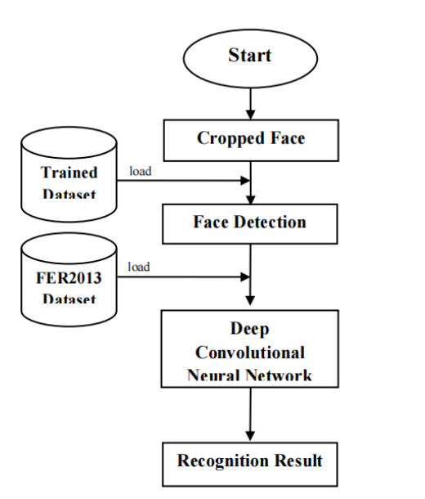
SYSTEM FLOWCHART:- fig 10(a).flowchart of training fig 10(b).flowchart of testing

Slide 10
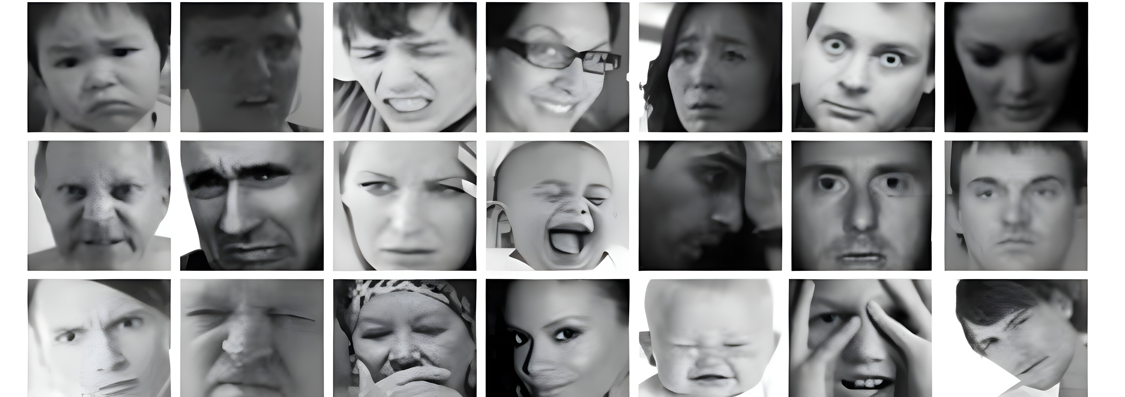
DATASETS USED:-
Includes both posed and unposed headshots.
FER-2013 :-
Source: Open-source dataset from Kaggle, created for a competition.
Purpose: Contains labeled grayscale images of faces for emotion recognition.
Image Details:
35,887 images in 48x48-pixel resolution.
Includes both posed and unposed headshots.
Emotions Covered: 7 categories:
Angry: 4,593 images
Disgust: 547 images
Fear: 5,121 images
Happy: 8,989 images
Sad: 6,077 images
Surprise: 4,002 images
Neutral: 6,198 images

Slide 11
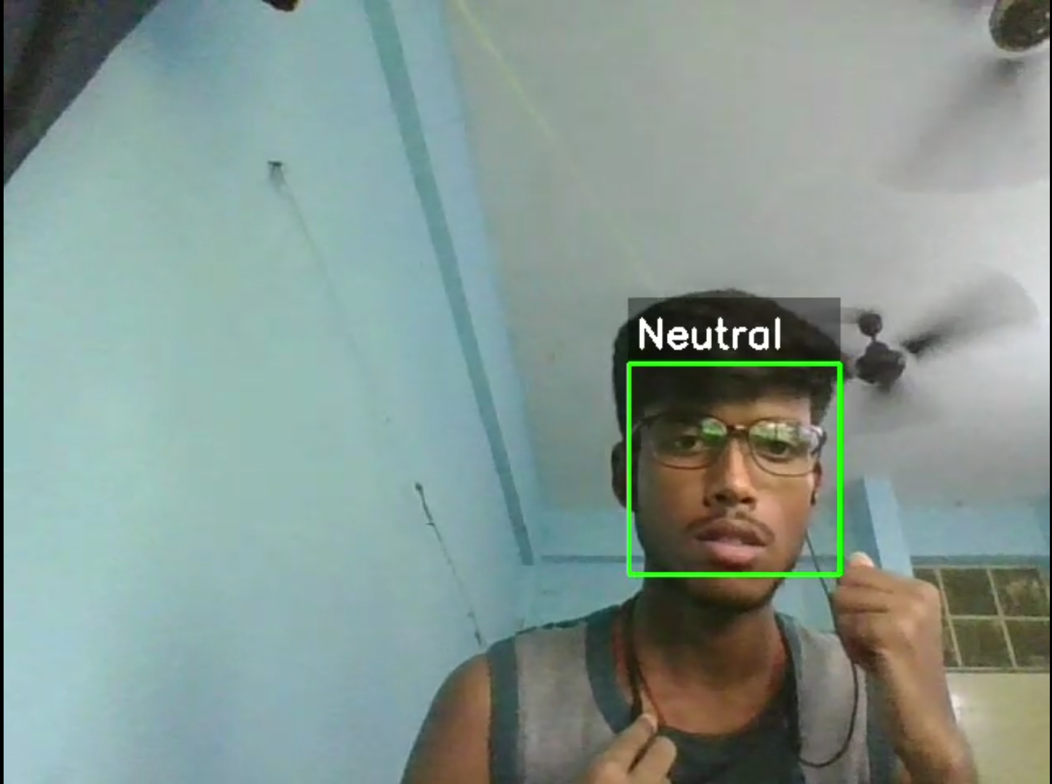
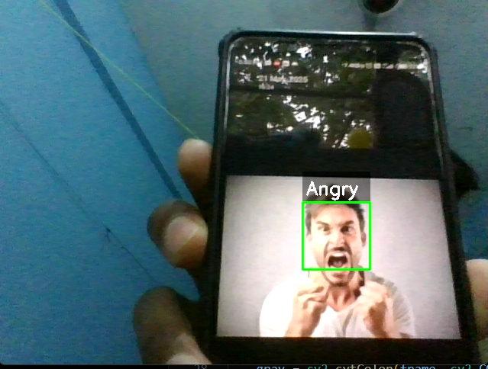
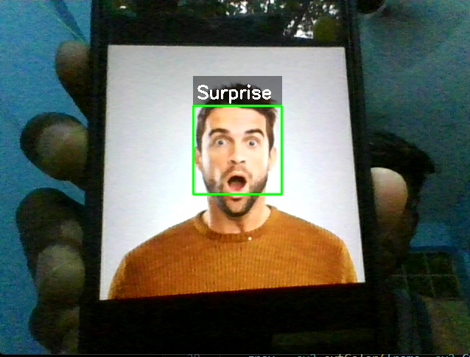
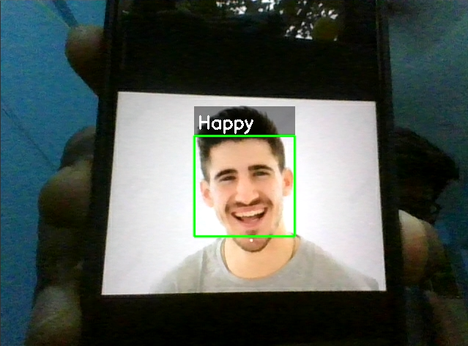
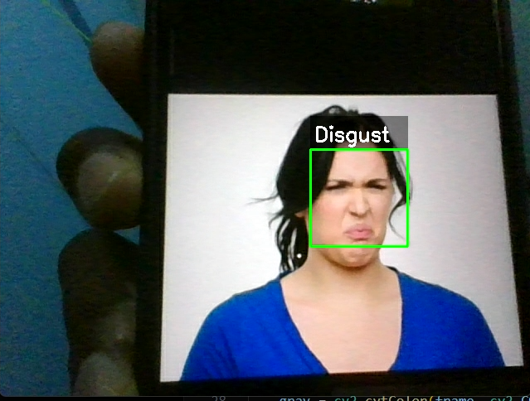
MODEL DEPLOYMENT:-

Slide 12
CONCLUSION:-
Successfully implemented a Real-Time Facial Emotion Recognition System using CNN and the FER-2013 dataset.
Demonstrated effective classification of emotions across 7 categories with reliable accuracy.
Showcased the potential of deep learning for enhancing human-computer interaction.
Highlighted applications in industries such as healthcare, education, entertainment, and customer service.
Provides a solid foundation for future improvements and real-world deployment.

Slide 13
FUTURE SCOPE:-
Emotion Prediction in Videos: Extend the system to recognize emotions dynamically over video sequences rather than just static images.
Enhancing Real-Time Performance: Optimize the model for faster processing and deployment on edge devices such as smartphones or IoT devices.
Cross-Domain Applications: Apply the technology in advanced domains like virtual reality (VR), augmented reality (AR), and human-computer interaction.
Real-World Applications: Deploy the model in practical use cases like healthcare, education, customer service, and mental health monitoring systems.

Slide 14
THANK YOU

